Slide 1
Transaction Interface
Types
typedef uint64_t coll_index_id_t
typedef unit64_t object_index_id_t
typedef unit64_t buffer_index_id_t
Write:
Transaction t = ObjectStore.new_transaction();
object_index_id_t h = t.get_objct(coll, obj);
buffer_index_id_t b = t.add_buffer(data);
t.write(h, off, len, b);
So , we can use lookup instead of encode/decode

Slide 2
Transaction Data
Types
struct FileStoreOp {
uint16_t version
uint16_t type;
uint16_t op_len;
} __attribute(packed)__ //and derived structs for each kind of op, fixed size
Fields
hash_map< coll_t, coll_index_id_t> coll_index
hash_map< ghobject_t, object_index_id_t> object_index
char* ops; //fill with FileStoreOp, self describe
bufferlist data; //for operation data, omap value,
Rules
coll/object index id begin from 0 and inc for each object.
buffer_index_id_t is the offset of data for a given bufferlist

Slide 3
Compare with current Transaction(PRIMARY)
 | Current |  | New
 | ENCODE | DECODE | ENCODE | DECODE
coll | EVERY | EVERY | ONE for EACH | NO
ghobject | EVERY | EVERY | ONE for EACH | NO
ops | EVERY | EVERY | Packed assign | NO
data & omap value | EVERY | EVERY | NO | NO
datas & omap value use the bufferlist directly from messenger or PG layer
FileJournal may use write_v to write data to disk, so no additional bufferlist
To transfer the transaction to replica, The transaction must be able to be represented by a bufferlist both for current and new transaction

Slide 4
Compare with current Transaction(REPLICA)
 | Current | New
 | DECODE | DECODE
coll | EVERY | ONE for EACH
ghobject | EVERY | ONE for EACH
ops | EVERY | one bufferlist.copy
data & omap value | EVERY | NO
datas & omap value use the bufferlist directly from messenger
FileJournal may use write_v to write data to disk, so no additional bufferlist

Slide 5
Transaction can be represented by bufferlist(s) to replica (and journal?)
4 Separate BufferList (Into One or Not)
Collection
hash_map< coll_t, coll_index_id_t> coll_index
Object
hash_map< ghobject_t, object_index_id_t> object_index
Operation
char* ops
Data
bufferlist data

Slide 6
Fast Encode/Decode for core data structure
Fast Encode
Calculate the size of the struct
Malloc memory
Assgin or Memcpy for each field
bufferlist.append
Test for ghojbect (4K Write Operation) by SystemTap

Slide 7
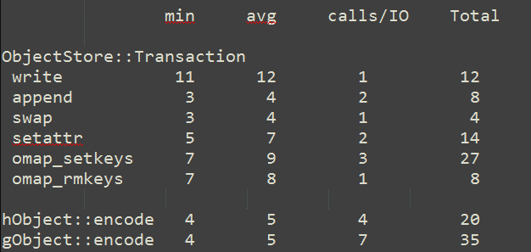
Encode/Decode Cost
4K Write Opeartion Encode Cost of PG layer: 80-100us
Decode will have the same cost
We may reduce 100+us by fast or no encode/decode

